Slide 1


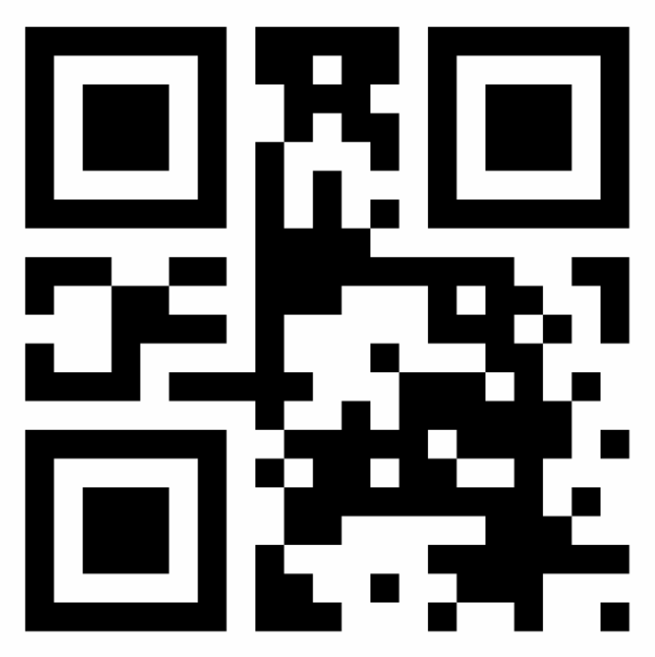




User approval to share
Brokers protect user’s privacy by requesting the user’s authorization before disclosing any of the user’s vaults and verifiable credentials. Given that wallets may be implemented with many different technology stacks from a push perspective, Brokers rely on simple webhooks to wallet’s APIs that in turn transform the requests to the wallet’s supported push technology. 3Ps requests contain suggested vaults to help users select from a set of 3P’s trusted vaults.
1
Upon check-in on 3rd Parties (3P), users shows their wallet’s QR. 3Ps extract the Broker domain and unique ID, and send a post request to the Broker with the list of information codes requested.
The Broker forwards the request to the webhook of the wallet’s API, for it to convert it into a push message that matches the wallet’s technology stack.
Before pushing the message, Brokers translate the info codes to the user’s preferred language by invoking the translation method on a trust graph.
The message sent from the wallet’s API to wallet’s app is already translated and filtered to show only the user’s vaults that support the codes requested by the 3P.
The user then selects the vaults that they are willing to share with the 3P, and they submit the selection and the attached verifiable credentials back to the Broker for redirection.
The Broker, in turn, sends that information to the 3P for processing.
Meanwhile, the wallet presents the user with a list of suggested vaults sent by the 3P, for the codes that were not supported by any of the user’s vaults. The user then clicks the suggested vaults to navigate to their login/registration UI.
When the check-in cycle is finished, the user is also able to access the 3P sticker that is generated by the 3P upon verifying the verifiable credentials and eventually communicating with the vaults for real-time validation and collect metadata.
2
Architecture
Sample scenario
1
3
Any Trust
Graph
3P online check-in 3P physical kiosk
get code translations
3
W
Open wallet
Scan QR
4
4
Share vaults with <3P>?
Passport
✓ IDnow
Vaccination status
✓ Very Fly
Special Service Requests
✓ French Mobility
Wallet’s user interface
1
post to domain
push
4
5
-
Notifier
OK
2
Cancel
Any 3rd Party
e.g. JP Airlines
webhook
Any Broker
e.g. Infosys
Any Wallet
e.g., ACME
6
-
Vault suggestions
ESTA (USA)
Seat preferences
Booking contacts
Allergies
<3P> Sticker
Download
Codes
Passport
Covid test
Wheelchair
Metadata
Flight: BA501
Date: 02/11/22
Expires: 10/01/22
post to domain
post to Broker domain
5
IDnow >>
⬇
7
S
6
IATA >>
8
8
7

